Slide 1

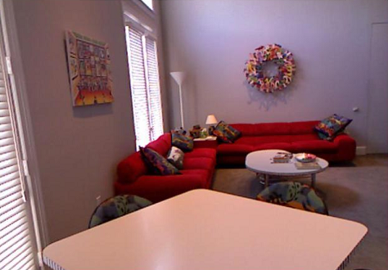
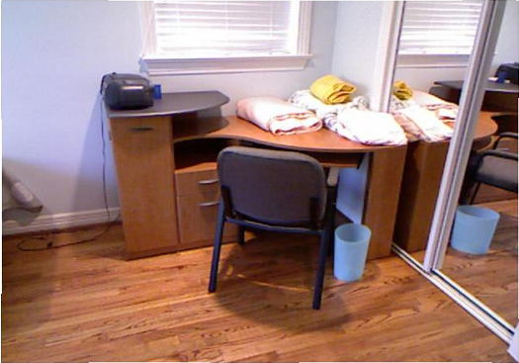
Visual Question Answering
(Badri Narayan Patro, Vinay Kumar Verma, Atanu Samanta)
Instructor: Dr. Vinay P Namboodiri
Abstract
Model
Results
Introduction
Recently, researchers in the field of image caption generation have combined computer vision (CV) and natural language processing (NLP) and developed methods of jointly learning from image and text inputs to form high level description. Visual Question Answering (VQA) involves an extra layer of interaction between human and computes.
This work implements a generic end to end QA model using visual semantic embedding to connect convolutional neural network (CNN) and recurrent neural network (RNN)
In this work the problem is simplified by restricting the questions to have only single word answer so that the problem can be treated as a classification problem.
The distribution of customer assignments ci is
P(ci=j | D,f,α) ∞ f(dij) if j≠i
∞ α if j=i ; dij is the distance between the data points i and j.f(d),the decay function mediates how distance between two data points affect their probability of connecting to each other i.e their probability of belonging to same cluster.
Discussion
Generative story
ddCRP is appropriate for image segmentation because it can account for the spatial structure of the superpixels through its distance function. We use a spatial distance between pixels to enforce a bias towards contiguous clustersThe full generative process for the observed features x1:N within a N-superpixel image is as follows:
1. For each sample parameters φk. ̴ Go.
2.For each customer ,sample a customer assignment ci ̴ ddCRP(α,f,D).This indirectly determines the cluster assignments z1:N and thus the segmentation
3.For each superpixel,independently sample observed data xi ̴ P(. | φ zi) Customer assignments are sampled using the spatial distance between pixels.The partition structure derived from the customer assignments is used to sample the observed image features.Given an image the posterior distribution of the customer assignments induces a posterior over the cluster structure ;providing segmentation.
References
What is there in front of the sofa?
Ground truth: table
How many chairs are there?
Ground truth: one
M. Ren, R. Kiros, and R. S. Zemel, “Exploring Models and Data for Image Question Answering,” CoRR, vol. abs/1505.02074, 2015
S. Antol, A. Agrawal, J. Lu, M. Mitchell, D. Batra, C. L. Zitnick, and D. Parikh, “VQA: Visual Question Answering,” CoRR, vol. abs/1505.00468,2015.
H. Gao, J. Mao, J. Zhou, Z. Huang, L. Wang, and W. Xu, “Are you talking to a machine? Dataset and methods for multilingual question answering,” CoRR, vol. abs/1505.05612, 2015.
L. Ma, Z. Lu, and H. Li, “Learning to answer questions from image using convolutional neural network,” CoRR, vol. abs/1506.00333, 2015.
ddCRP
S
S
S
ddCRP, a generalization of the CRP, models customers linking to other customers .The seating plan is a byproduct of these links –two customers are sitting at the same table if one can reach the other by traversing the customer assignments .
NP
VP
WHNP
VP
DET
N
V
VBG
NP
NP
WP
V
DET
NP
N
V
NP
a
cat
is
DET
N
what
is
the
cat
is
VBG
WHNP
wearing
a
hat
wearing
WP
Syntax Tree Example: “A cat is wearing a hat” => “What is the cat wearing?”
what
CS676A Course Project Group: G30 Indian Institute of Technology, Kanpur

